Slide 1
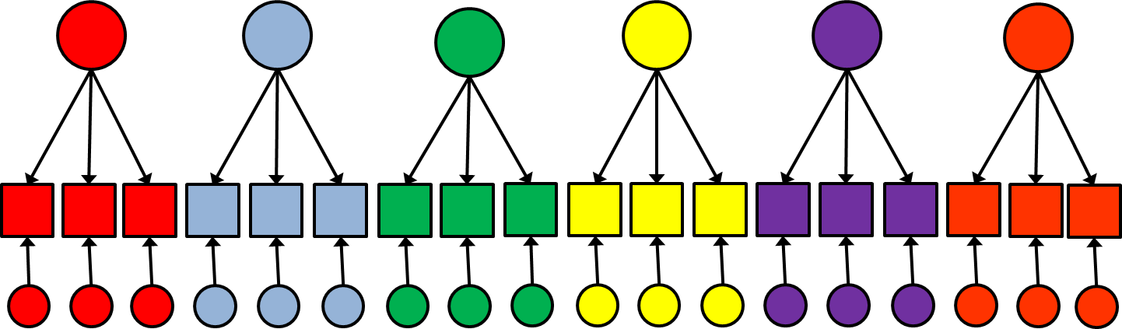
Latent Variable Modeling
Confirmatory Factor Analysis (CFA)

Slide 2

Introductions

Slide 3
Why latent variable models?
psychological construct
not observable =
latent variable
degree of depression
observable behavior
operational definitions
response to item
‘I feel sad’
Notes:
3
A core problem with psychological measurement is that the psychological construct that we wish to measure is often unobserved. Therefore, instead, we measure observable behavior that we think is reflective of the psychological construct that we want to measure. We usually measure several different behviors.

Slide 4
Why latent variable models?
degree of depression
Item 1
Item 2
Item 3
Item 4
Item 5
Notes:
4
For example, five items: feeling down or blue, having appetite, being tired, etc.
We use these items to say something about someone’s depression, for example by calculating a sumscore. However, to be able interpret such a sumsocore as indeed being indicative of someone’s level of depression, we make some theoretical jumps. Because this model also relies heavily on theory

Slide 5
Why latent variable models?
Measurement models link a latent variable with observations (e.g., individuals’ responses to a set of questions, or items) that reflect a theoretical construct.
These models operationalize propositions about the relationships between a theoretical construct and its observed measurement indicators (items)
Notes:
That is, the latent variable model is a measurement model, that makes quite strong theoretical assumptions about the relationships between the observed variables (items or measurement indicators) and the underlying construct (latent variable).

Slide 6
Why latent variable models?
Cognitive?
degree of depression
Physical?
Item 1
Item 2
Item 3
Item 4
Item 5
Notes:
6
For example, are all these 5 items indeed reflective of depression, and not of something else? Can we really capture depression into one sumscore? Often psychological constructs are more complex. Maybe there are cognitive aspects, and physical aspects that we should distinguish.

Slide 7
Why latent variable models?
degree of depression
Cognitive problems
Physical problems
Item 1
Item 2
Item 3
Item 4
Item 5
Notes:
7
And we would have a multidimensional measurement model of depression, with cognitive and emotional problems.

Slide 8
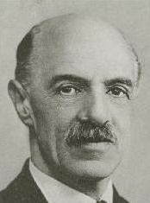
Why latent variable models?
Intelligence tests
Intellectual ability tests are all positively correlated -> positive manifold
Is there one underlying general intelligence dimension: g factor?
Charles Spearman
WM
Arithmetics
Spatial
Perceptual
Processing
Verbal
Notes:
8

Slide 9

Why latent variable models?
Personality tests
How many dimensions?
Hundreds of questions about personality traits can be reduced to five underlying dimensions
Notes:
9

Slide 10
Structural Equation Modeling (SEM)
Regression analysis
Factor analysis
Path analysis (Wright)
Covariance structure analysis (Jöreskog)
Structural Equation Modeling with Latent Variables

Slide 11
Everything is regression
ε_{Y}
Structural Model
Multiple Y’s
Y
ε_{Y}
Latent!
X
ε_{Y}
X
Y
Y
Factor model
Simple regression model

Slide 12

What is a model?
A simplified description, especially a mathematical one, of a system or process, to assist calculations and predictions (Oxford dictionary)

Slide 13
Confirmatory Factor Analysis (CFA)
Latent variables and indicators
Psychological constructs (intelligence, extraversion, etc.) are not directly observable / measurable → latent variables.
Measurements (test scores) are indicators of these latent variables: correlated with, but not identical → measured with error.

Slide 14
Confirmatory Factor Analysis (CFA)
Classical test model: X_{i} = T_{i} + E_{i} . Observed score (indicator) = true score (latent variable) + measurement error.
Latent variables represent the common cause that explaines the covariance among the indicators
Analogous to “true score”” in CTT
Everything that an indicator has not in common with other indicators is represented by the unique factors
Analogous to residuals in regression

Slide 15
Confirmatory Factor Analysis (CFA)
degree of depression
Item 1
Item 2
Item 3
Item 4
Item 5
Notes:
15

Slide 16
Confirmatory Factor Analysis (CFA)
Measurement error
A variable might be measured perfectly (without error) IF it can be directly observed
e.g., smoking frequency, voting behavior
But: we often have indirect measures!
e.g., self-reported smoking behavior, intent to vote
Such measures are influenced by:
What we want to measure (“true score”)
Random fluctuations and nuisance factors (e.g., how we want to be perceived), collectively called measurement error

Slide 17
Depression
Appetite
Concentration
Worrying
Fatigue
D
S₁
e₁
D
S₂
e₂
D
S₃
e₃
D
S₄
e₄
ε₁
ε₂
ε₃
ε₄

Slide 18
Confirmatory Factor Analysis (CFA)
CFA vs EFA
Exploratory (PCA, EFA). We determine empirically how many factors / components and which items load on which factors.
Confirmatory (CFA). We have explicit model (based on theory) about (a) how many factors, (b) correlations between factors, (c) which items load on which factors.
- Model imposes constraints on some model parameters (e.g. factor loadings or correlations between factors are set to zero).
- Constraints can be right or wrong (model is correct or not) in light of data → statistical test of model.

Slide 19
Motivation
Satisfaction
Self-
Confidence
LO
CO
HM
FU
AC
TE
SE
SF
SK
ε_{LO}
ε_{CO}
ε_{HM}
ε_{FU}
ε_{AC}
ε_{TE}
ε_{SE}
ε_{SF}
ε_{SK}
Notes:
Motivatie: Leertaak gerichtheid, concentratie in de klas, huiswerk attitude
Welbevinden: plezier op school, social aanvaard voelen, relatie met leekrachten
Zelfvertrouwen: uitdrukkingsvaardigheid, zekerheid bij proefwerken, sociale vaardigheid

Slide 20
Motivation
Satisfaction
Self-
Confidence
LO
CO
HM
FU
AC
TE
SE
SF
SK
ε_{LO}
ε_{CO}
ε_{HM}
ε_{FU}
ε_{AC}
ε_{TE}
ε_{SE}
ε_{SF}
ε_{SK}

Slide 21
Confirmatory Factor Analysis (CFA)
Let’s look at an example in R
Use the SVL_example.R document from github

Slide 22
Confirmatory Factor Analysis (CFA)
Theory / research
1. Model specification. Make model (based on theory / previous research).
2. Model identification. Decide whether model can be estimated and/or tested.
3. Parameter estimation. Use data to estimate model coefficients (e.g. factor loadings), under (provisional) assumption that model is correct.
4. Model evaluation. Use data and parameter estimates for statistical tests + fit measures, to determine whether model is defensible.
Model respecification. If model is not good enough, investigate how it can be improved (then repeat steps 2 to 4, and if necessary, step 5, and so on).
Model interpretation. Describe results
Specification
Model
Data
Estimation
Parameter estimates
Evaluation
Test / fit
measures
If OK.
Interpretation
If not OK.
Respecification
Describe results

Slide 23
Step 1: Model specification
Theory → Model
What concept are we measuring?
How many dimensions?
How many / what aspects of the concept?
Which item loads on which dimension?
What aspect does the item measure?

Slide 24
Step 1: Model specification
Theory → Model
What concept are we measuring?
How many dimensions?
How many / what aspects of the concept?
Which item loads on which dimension?
What aspect does the item measure?

Slide 25
Motivation
Satisfaction
Self-
confidence
LO
CO
HM
FU
AC
TE
SE
SF
SK
ε_{LO}
ε_{CO}
ε_{HM}
ε_{FU}
ε_{AC}
ε_{TE}
ε_{SE}
ε_{SF}
ε_{SK}

Slide 26
Step 1: Model specification
Six observed variables:
X₁: fun at school
X₂: acceptance by classmates
X₃: relationship with teacher
X₄: self-expression
X₅: self-efficacy
X₆: social skills
X₁
X₂
F₁
X₃
X₄
Theory
X₁ to X₃ measure satisfaction with school life
X₄ to X₆ measure self-confidence about scholastic activities
X₅
F₂
X₆

Slide 27
Step 1: Model specification
Symbols for variables
Symbols for relationships
E₁
X₁
satisfaction
X
Manifest variables
Latent variables
Error variables
X predicts / explains Y
(as in regression)
X is related to Y,
neutral about causal nature
of relationship (as in correlation)
E₂
X₂
F₁
F
E₃
X₃
E
E₄
X₄
X Y
X Y
E₅
X₅
F₂
selfconfidence
E₆
X₆

Slide 28
Step 1: Model specification
• All single arrows go from latent to manifest.
• Each predicted variable (incoming arrow) gets an error term.
• If necessary, double arrows between (a) two factors, and/or (b) two errors.
• No arrows (single or double) between manifest variables (CFA assumption: relationships between manifest variables are fully explained by factors and errors).
• No arrows (also no double arrows) between factors and errors (CFA assumption).
E₁
X₁
satisfaction
E₂
X₂
F₁
E₃
X₃
E₄
X₄
E₅
X₅
F₂
selfconfidence
E₆
X₆

Slide 29
Step 1: Model specification
E₁
1
1
1
1
1
1
X₁
λ₁₁
Instead of an arrow diagram we can use structural equations
Each path (arrow) has a model parameter (or path coefficient)
satisfaction
λ₂₁
E₂
X₂
F₁
λ₃₁
E₃
X₃
E₄
X₄
λ₄₂
Plus statements
about correlations between latent
variables
λ₅₂
E₅
X₅
F₂
E₆
X₆
λ₆₂
selfconfidence
λ_{ij} is loading of variable i on factor j

Slide 30
Step 1: Model specification
E₁
X₁
Omission of possible arrow from SEM-model does not mean “no idea!”, but assumption that the parameter concerned is exactly zero.
Omitted arrows form constraints of
model (which make it testable).
Constraints in example
• Factor loadings:
λ₁₂ = λ₂₂ = λ₃₂ = λ₄₁ = λ₅₁ = λ₆₁ = 0
• Correlations between errors:
r_{E1,E2} = r_{E1,E3} = ..... = r_{E5,E6} = 0
E₂
X₂
F₁
E₃
X₃
E₄
X₄
E₅
X₅
F₂
E₆
X₆

Slide 31
Step 2: Model identification
Once we have specified our model of interest we should investigate whether the model is identified
Is there enough known information to obtain unique estimates of the model parameters?
Known information → sample variances and covariances
Number of variances and covariances (V); with k manifest variables, V = k (k + 1) / 2.
Unknown information → model parameters (P)

Slide 32
Step 2: Model identification
Number of parameters to be estimated (P) must be smaller than number of observed variances and covariances (V)
Degrees of freedom (df) = V – P.
Model is testable if and only if df > 0
Necessary, but not sufficient

Slide 33
Step 2: Model identification
Parallel: equations
with two unknowns
If (df < 0):
x – 2y = 0
Infinite number of solutions.
If (df = 0):
x – 2y = 0
x + y = 9
One (unique) solution:
x = 6 and y = 3.
If (df > 0):
x – 2y = 0
x + y = 9
2x - 3y = 6
No perfect solution,
but there is an optimal, “least bad” solution.
Three possibilities
df < 0: under-identified. No unique
solution or unique parameter estimates
and not testable.
df = 0: precisely identified. Perfect
(but usually unstable) solution (therefore
no error): there are unique parameter
estimates, but model is not testable.
df > 0: over-identified. Imperfect
solution (therefore error), unique parameter
estimates: model is testable.
Warning!
Model can also be empirically under-identified
(because of dependencies in data).

Slide 34
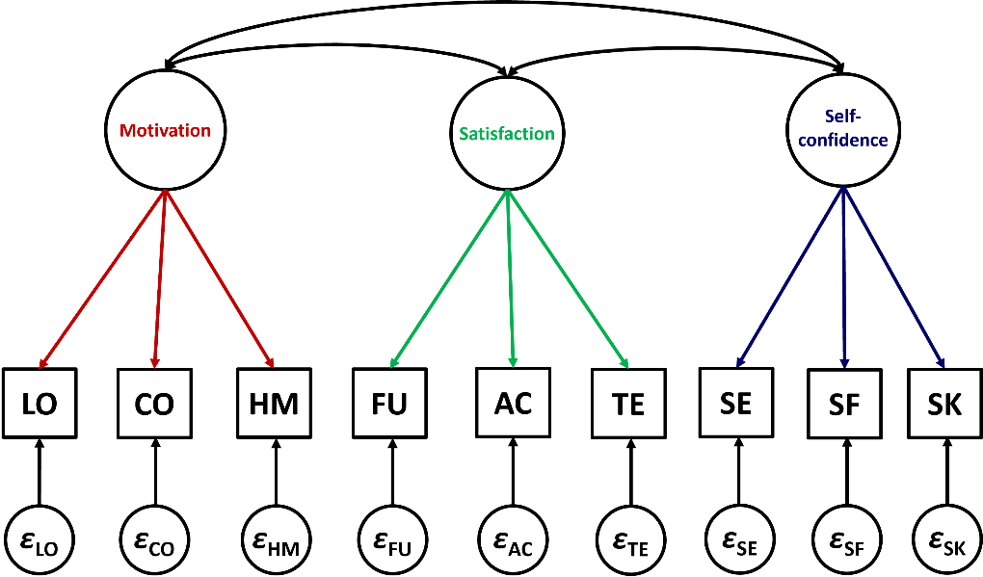
Step 2: Model identification
Identification in example
Number of variances plus covariances?
V = ?
Number of relationships:
P = ?
Degrees of freedom:
df = V - P = ?
Model identified?
Yes, because df > 0

Slide 35
Step 2: Model identification
Additional requirement for identification: a scale for each latent variable
A positive number of degrees of freedom does not automatically lead to a unique solution, for the following reason.
If factor loading for X_{i} on F_{j} is λ_{ij}, then: X_{i} = λ_{ij}F_{j} + E_{i}.
But: if λ₁₁ is multiplied by an arbitrary number a and at the same time F₁ is multiplied by 1/a, prediction remains exactly the same.
→ Infinite number of equivalent solutions.
Unique solution requires that scale (variance) of factor is arranged by one of following options:
- setting the variance of each factor to a fixed value (usually 1);
- for each factor setting one factor loading to a fixed value (usually 1).
For practical purposes it does not matter: different unstandardised solutions, but identical standardised solutions.

Slide 36
Step 2: Model identification
Let’s go back to our example in R

Slide 37
Step 3: Model estimation
Questionnaire administered to 915 children
E₁
X₁
E₂
X₂
F₁
E₃
X₃
E₄
X₄
E₅
X₅
F₂
E₆
X₆

Slide 38
Step 3: Model estimation
E₁
X₁
Variance-covariance matrix (or correlation matrix = variance-covariance matrix of standardised variables) plus number of cases.
E₂
X₂
F₁
47.83
15.13 | 20.54
26.90 | 17.65 | 62.58
8.45 | 3.40 | 9.18 | 12.69
12.82 | 4.09 | 13.41 | 13.04 | 25.54
13.21 | 6.93 | 24.28 | 22.02 | 29.24 | 69.20
E₃
X₃
E₄
X₄
E₅
X₅
F₂
Red and italic: variances (on diagonal)
Blue: covariances
E₆
X₆

Slide 39
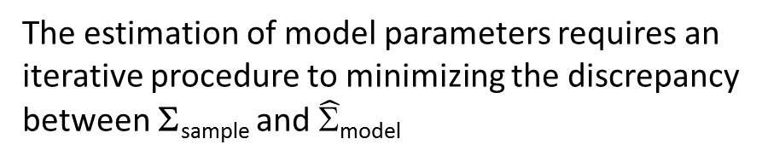
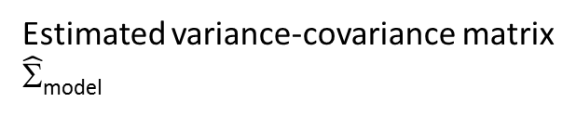
Step 3: Model estimation
47.83
15.13 | 20.54
26.90 | 17.65 | 62.58
8.45 | 3.40 | 9.18 | 12.69
12.82 | 4.09 | 13.41 | 13.04 | 25.54
13.21 | 6.93 | 24.28 | 22.02 | 29.24 | 69.20
?
? | ?
? | ? | ?
? | ? | ? | ?
? | ? | ? | ? | ?
? | ? | ? | ? | ? | ?
Observed variance-covariance matrix
Σ_{sample}
Estimated variance-covariance matrix
$\hat{Σ}$_{model}
Over-identified models
(df > 0):
x – 2y = 0
x + y = 9
2x - 3y = 6
No perfect solution,
but there is an optimal, “least bad” solution.
The estimation of model parameters requires an iterative procedure to minimizing the discrepancy between Σ_{sample} and $\hat{Σ}$_{model}

Slide 40
Step 4: Model evaluation
Most widely used discrepancy function is the maximum likelihood (ML) function:
It provides ML estimates of all model parameters and a chi-square value that can be used to test the exact fit (i.e., Σ_{population} = Σ_{model}) of the model:
F_{ML}(Σ_{sample}, $\hat{Σ}$_{model}) = log|$\hat{Σ}$_{model}| ‑ log|Σ_{sample}| + trace(Σ_{sample} $\hat{Σ}$_{model}^{‑1}) ‑ p ,
χ² = (N - 1) F_{ML}

Slide 41
Step 4: Model evaluation
Chi-square test for exact fit
H0: Σ_{population} = Σ_{model}
HA: Σ_{population} ≠ Σ_{model}
So, when the chi-square test is significant we reject H0 (and thus the model)
But… we specify a model that we expect to be a good (true) model, we thus do not whish to reject H0…

Slide 42
Step 4: Model evaluation
Practical problems with the chi-square test of exact fit
With large N, it becomes significant very easily, even when there is only a small divergence between model and data (large N is needed in CFA, because otherwise parameter estimates are unstable).
The hypothesis of exact fit may not be of interest.
Therefore, also look at descriptive goodness-of-fit measures: these show in different ways the extent to which data agree with the model.

Slide 43
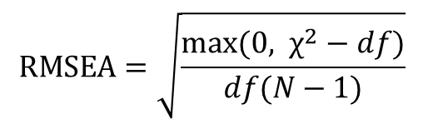
Step 4: Model evaluation
Descriptive goodness-of-fit measures: approximate fit
RMSEA (root mean square error of approximation).
Value smaller than 0.05 indicates good fit; between .05 and .08 adequate fit, and above .10 poor fit.
$$RMSEA=\sqrt{\frac{max⁡(0, χ^{2}−df)}{df(N−1)}}$$
“Baddness of fit index” : Measures the degree of misfit per df
Steiger & Lindt, 1980; Schermmeleh-Engel & Moosbrugger, 2003

Slide 44
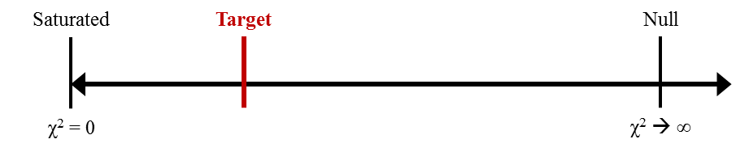
Step 4: Model evaluation
Descriptive goodness-of-fit measures: comparative fit
NFI (normed fit index).
Values > .90. indicate acceptable fit, and > .95 good fit
CFI (comparative fit index).
Values > .95. indicate acceptable fit, and > .97 good fit
Schermmeleh-Engel & Moosbrugger, 2003

Slide 45
Step 4: Model evaluation
Number of parameters Chi-square test Fit measures
• Chi-squared test: χ²(8) = 82.79, p < .001; significant, so data say “no” to model (but test becomes very easily significant with large N).
• NFI < .90, CFI < .95 and RMSEA > .10: descriptive fit indices also indicate the model has insufficient fit.

Slide 46

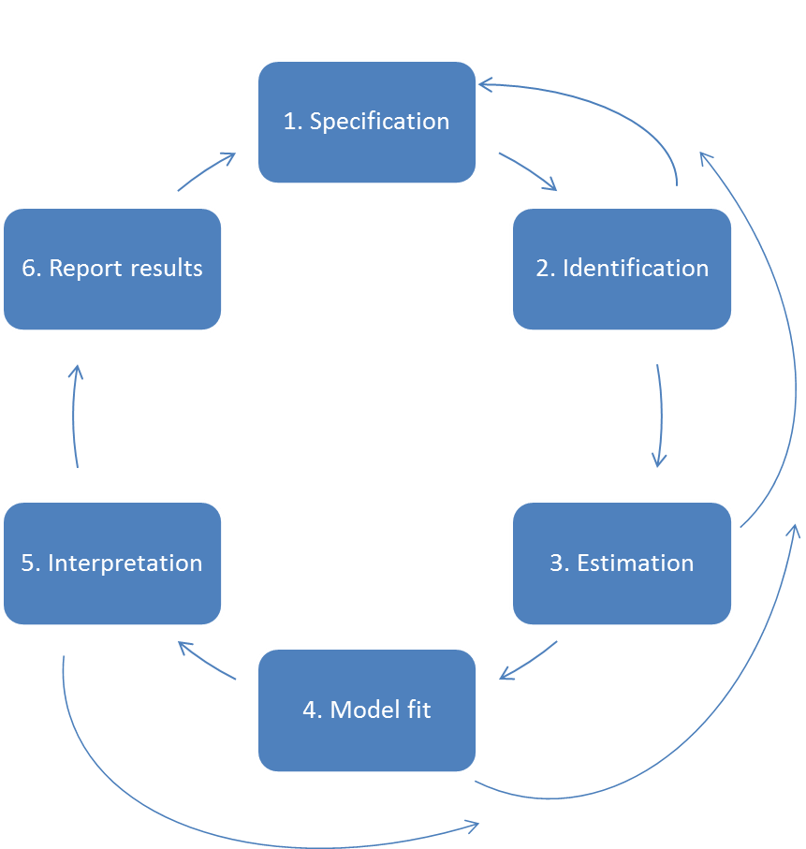

Step 4: Model evaluation

Slide 47
Step 4: Model evaluation
Let’s go back to our example in R
-> What is your conclusion about model fit?

Slide 48
Model respecification
Why is there a bad fit? How to look for improvement?
Look at modification indices.
Look at standardised residuals.
Warning! Purely data-driven modifications capitalize on chance, resulting in ungeneralizeable models. Theory should always be your guide.
Post-hoc
modification!

Slide 49

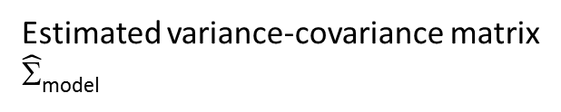
Model respecification
Standardised residual
Σ_{residual} = Σ_{sample} - $\hat{Σ}$_{model}
47.83
15.13 | 20.54
26.90 | 17.65 | 62.58
8.45 | 3.40 | 9.18 | 12.69
12.82 | 4.09 | 13.41 | 13.04 | 25.54
13.21 | 6.93 | 24.28 | 22.02 | 29.24 | 69.20
?
? | ?
? | ? | ?
? | ? | ? | ?
? | ? | ? | ? | ?
? | ? | ? | ? | ? | ?
Observed variance-covariance matrix
Σ_{sample}
Estimated variance-covariance matrix
$\hat{Σ}$_{model}

Slide 50

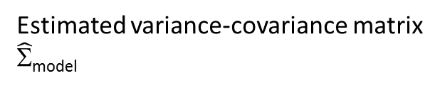
Model respecification
Σ_{residual} = Σ_{sample} - $\hat{Σ}$_{model} =
47.83
15.13 | 20.54
26.90 | 17.65 | 62.58
8.45 | 3.40 | 9.18 | 12.69
12.82 | 4.09 | 13.41 | 13.04 | 25.54
13.21 | 6.93 | 24.28 | 22.02 | 29.24 | 69.20
47.83
15.13 | 20.54
26.90 | 17.65 | 62.58
8.45 | 3.40 | 9.18 | 12.69
12.82 | 4.09 | 13.41 | 13.04 | 25.54
13.21 | 6.93 | 24.28 | 22.02 | 29.24 | 69.20
Observed variance-covariance matrix
Σ_{sample}
Estimated variance-covariance matrix
$\hat{Σ}$_{model}
0
0 | 0
0 | 0 | 0
0 | 0 | 0 | 0
0 | 0 | 0 | 0 | 0
0 | 0 | 0 | 0 | 0 | 0

Slide 51
Model respecification
Σ_{residual} = Σ_{sample} - $\hat{Σ}$_{model} =
47.83
15.13 | 20.54
26.90 | 17.65 | 62.58
8.45 | 3.40 | 9.18 | 12.69
12.82 | 4.09 | 13.41 | 13.04 | 25.54
13.21 | 6.93 | 24.28 | 22.02 | 29.24 | 69.20
47.83
15.13 | 20.54
26.90 | 17.65 | 62.58
8.45 | 3.40 | 9.18 | 12.69
2.82 | 4.09 | 13.41 | 13.04 | 25.54
13.21 | 6.93 | 24.28 | 22.02 | 29.24 | 69.20
Observed variance-covariance matrix
Σ_{sample}
Estimated variance-covariance matrix
$\hat{Σ}$_{model}
0
0 | 0
0 | 0 | 0
0 | 0 | 0 | 0
10 | 0 | 0 | 0 | 0
0 | 0 | 0 | 0 | 0 | 0

Slide 52
Model respecification
Possible model improvements
Improve fit by setting fixed parameters
free. Can be done in two ways.
• Factor loadings: one variable measures more than one factor
e.g. X₄ (self expression) may load on satisfaction factor.
• Correlated errors: two variables measure something else
e.g. X₃ (relationship teachers) and X₆ (social skills) may both depend on extraversion.
E₁
X₁
satisfaction
E₂
X₂
F₁
E₃
X₃
E₄
X₄
E₅
X₅
F₂
selfconfidence
E₆
X₆

Slide 53
Model respecification
Standardised residual: zres_{ij} = r_{ij} - r_{ij}, difference between actual and implied correlation between X_{i} and X_{j}.
Which standardised residuals are large (> .10 or < -.10)? If residuals for a certain variable are large, our model for that variable is not correct.
Do residuals show normal distribution? Symmetry of distribution? Centered around zero point?

Slide 54
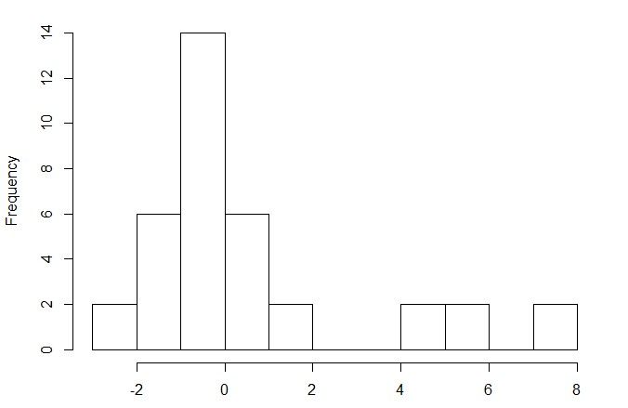
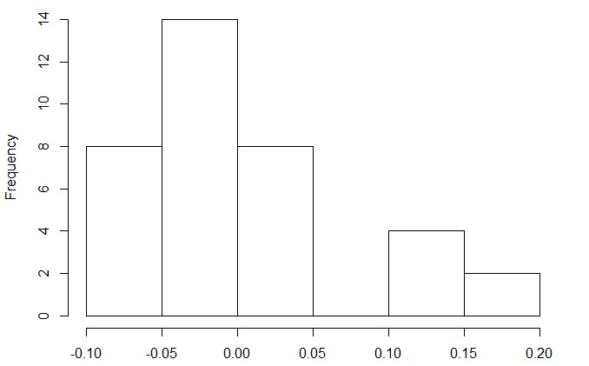
Model respecification

Slide 55
Model respecification
Striking pattern
• All high residuals (red and italic) are from the same variable (acceptance by classmates) with all variables from the other factor.
FU AC TE SE SF SK
FU
AC
TE
SE
SF
SK
0
-.02 | 0
.01 | -.02 | 0
.05 | .10 | .02 | 0
-.06 | .10 | -.05 | -.00 | 0
-.06 | .16 | -.06 | -.01 | .02 | 0
Improvement
Add factorloading

Slide 56
E₁
X₁
Like first model,
but with correlated factors.
Lavaan model evaluation output
• Chi-square still significant:
χ²(7) = 32.77, p < .001.
• Fit measures: NFI > .95,
CFI > .95, so OK!
…. but RMSEA >.10.
So data are somewhat compatible with adjusted model.
satisfaction
E₂
X₂
F₁
E₃
X₃
E₄
X₄
E₅
X₅
F₂
selfconfidence
E₆
X₆

Slide 57
Model respecification
Look again at the residuals
• No longer any large residuals
0
-.02 | 0
.01 | -.02 | 0
.05 | .01 | .02 | 0
-.06 | .00 | -.05 | -.00 | 0
-.06 | -.02 | -.06 | -.01 | .02 | 0

Slide 58
Model evaluation

Slide 59
Step 5: Model interpretation
Unstandardized factor loadings
Standardized
Loading Standard error test value p value Ignore factor loading
Covariance Std. error test value p value Ignore Correlation

Slide 60
Step 5: Model interpretation
Res. variance Std. error test value p value Ignore Std. residual var = ?
Variance = 1 -> why?

Slide 61
Step 5: Model interpretation
.51
.57
.46
.23
.32
.29
X₁
.70
satisfaction
.65
X₂
F₁
.74
X₃
.53
.49
X₄
.88
.83
X₅
F₂
selfconfidence
.84
X₆

Slide 62

So has the model now been proved?
Step 5: Model interpretation
There are so
many others!
Not really...
• A model is either rejected by the data (the data say “no”), or ...
• ... the model is compatible with the data.
But even then, the data are also compatible with many alternative models (so at most the data say “maybe”).
Although I
am compatible with him, I can’t say “yes”...
Ehh... Maybe!
O Data, let me be your model!
Huh ...?
Model
Data
The data are playing “hard to get”

Slide 63
Step 5: Model interpretation
Testing model modifications
The model with more parameters always fits better, but does it fit significantly better?
The χ² difference test (Δχ²) test can be used to test the difference in model fit between two nested models:

Slide 64
Step 5: Model interpretation
Let’s go back to our example in R

Slide 65
Step 5: Model interpretation

Slide 66
Try for yourself
There is an additional exercise on CFA on the github page

